Slide 1
Second Life – The Upper Limb
A walk through detailing the bones, muscles, arteries, veins, lymphatic system, and innervation of the arm.

Slide 2
Second Life – The Upper Limb
The Upper Limb will be presented in three different modules:
The Arm
The Forearm
The Hand
Within each module relevant structure of bone, muscle, arterial supply, venous supply, lymphatic system, and nerve innervation will be described as a unit.

Slide 3
Second Life –The Upper Limb
Atlas of Anatomy images are Copyright ©2008 by Thieme. All rights reserved. Illustrators: Markus Voll & Karl Wesker
Human Anatomy base reference for text Copyright ©2005 by Saladin. All rights reserved. McGraw-Hill Companies, Inc.

Slide 4
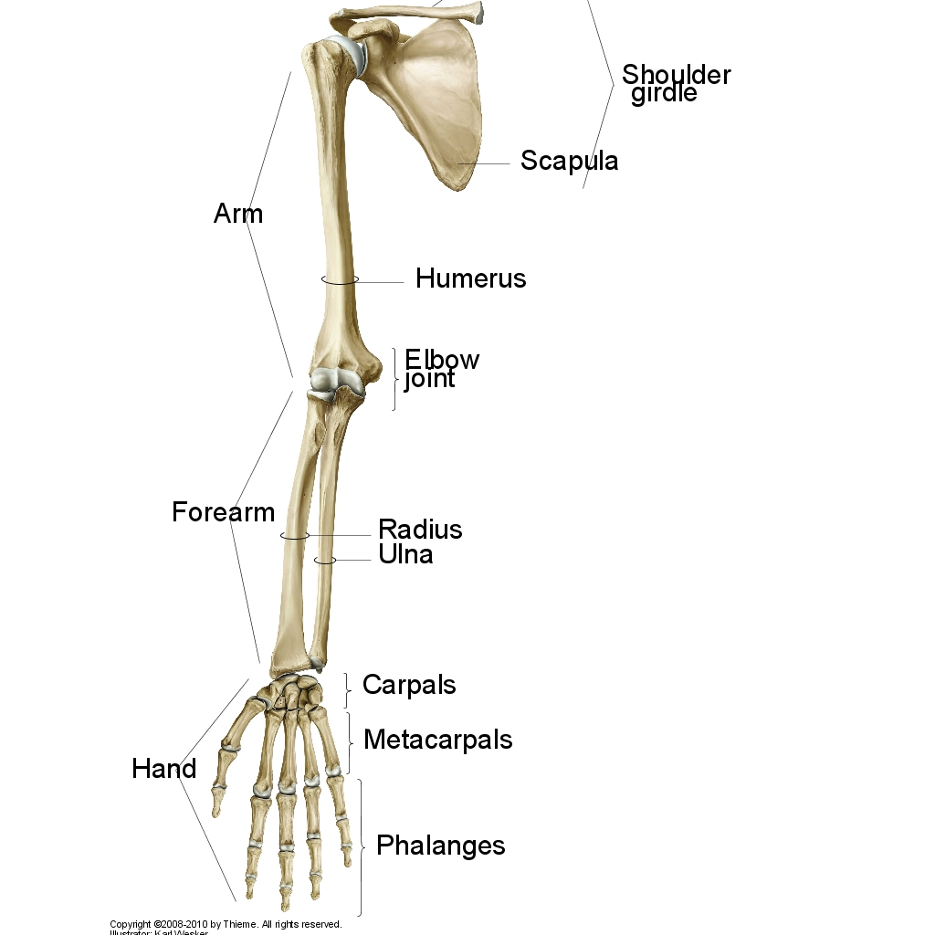
Distinct Regions of the Upper Limb
The upper limb in subdivided into three regions: arm, forearm, and hand.
These regions comprise the entire upper limb, which is attached to the body at the pectoral girdle.
We will take an in-depth look at each of these three distinct upper limb regions. First let’s begin by understanding the structure and function of the arm.

Slide 5
The Humerus
We will begin by covering the surface anatomy of the humerus. Understanding the features of this bone will provide the foundation for learning about the rest of the arm.
The arm proper, or brachium (BRAY-kee-um) extends from shoulder to elbow. Only one bone composes the arm: the humerus.
There are several muscles acting on the humerus. Before we look at the muscles of the arm, there are numerous features that make up the humeral surface.

Slide 6
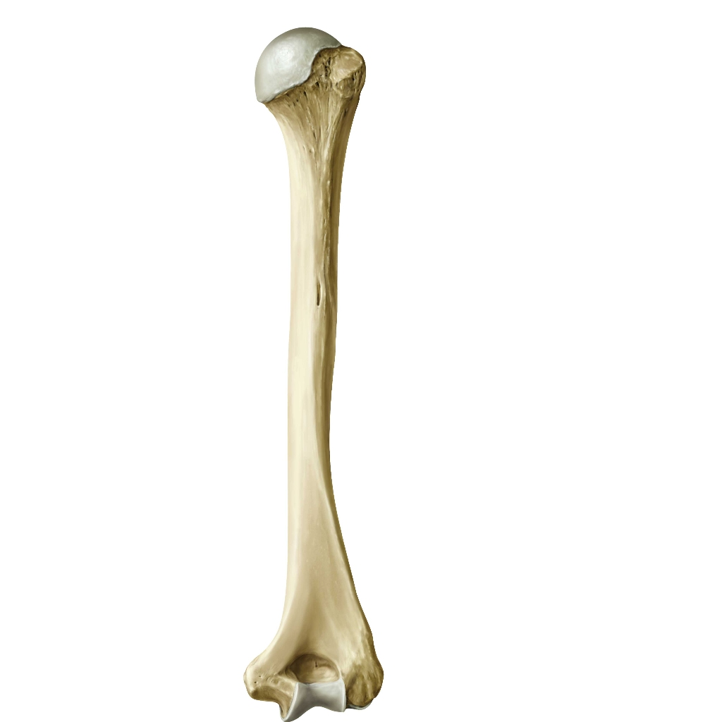
Proximal Features of the HUMERUS
Right Humerus:
Posterior View
Head of Humerus
Greater tuberosity
The proximal end of the humerus has a head that articulates with the glenoid cavity of the scapula. This smooth surface of the head is covered with articular cartilage and bordered by a groove called the anatomical neck and greater tuberosity.
Articular cartilage is white and glossy, and has a rubbery consistency. This slippery surface allows for surfaces to move with little friction and prevent damage to surrounding tissue. In the shoulder, articular cartilage covers the head of the humerus and the socket area of the glenoid (glenoid fossa) on the scapula.
The surgical neck is located just above the shaft of the humerus. This narrowing of the bone is distal to the tubercles at the transition from the head to the shaft.
Anatomical neck
Surgical neck

Slide 7
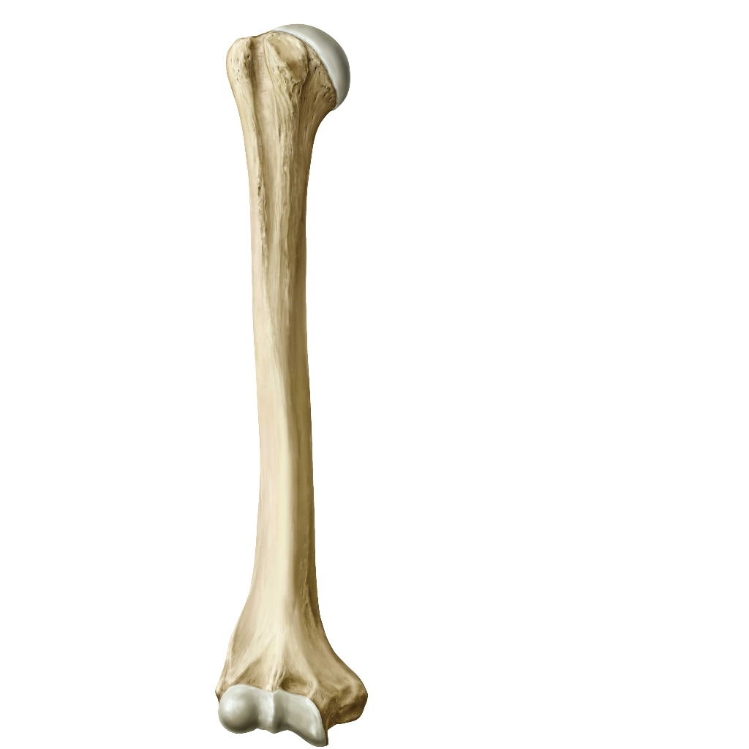
Right Humerus:
Anterior View
Proximal Features of the HUMERUS
This anterior view shows the shaft of the humerus which has a rough lateral surface area called the deltoid tuberosity. This tuberosity is the insertion for the deltoid muscle.
The intertubular groove located between the two tuberosities, accomodates the tendon of the long head of the biceps brachii.
Greater tuberosity
Lesser tuberosity
Intertubercular groove
On the proximal end of the humerus, the surgical neck is the area most commonly fractured. The name “surgical neck” is given to this part of the humerus for this reason. Why do you think this area would be so likely to fracture?
Clinical Application:
Deltoid tuberosity

Slide 8
Distal Features of the HUMERUS:
Right Humerus:
Posterior View
Distal features of the humerus are the lateral and medial epicondyles . These large bony prominences are distinct and can be palpated from the surface of the skin. The medial epicondyle protects the ulnar nerve which passes close to the surface on the back side of the elbow.
The distal end of the humerus also has deep pits, two on the anterior side (next slide) and one posterior space. To the left we see the olcranon fossa which articulates with the olcranon of the ulna during elbow extension and flexion.
Olcranon fossa
Lateral epicondyle
Medial epicondyle

Slide 9
Distal Features of the HUMERUS:
Right Humerus:
Anterior View
From the previous slide we viewed one of the distal deep pits in the humerus (olcranon fossa). On the picture to the left, note the other two deep pits on the anterior surface, the coronoid fossa and the radial fossa.
These fossae accommodate the coronoid process of the ulna when the elbow is flexed.
Moreover, the distal side of the humerus shows two condyles called the capitulum and trochlea which articulate with the radius and ulna, respectively.
Immediately proximal to these condyles are the bony processes of the lateral and medial epicondyles.
Radial fossa
Coronoid fossa
Capitulum
Trochlea

Slide 10
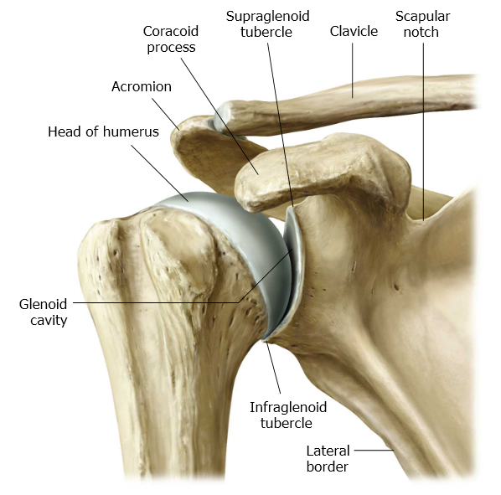
The Shoulder Joint
The head of the humerus articulates at the glenoid cavity of the scapula.

Slide 11
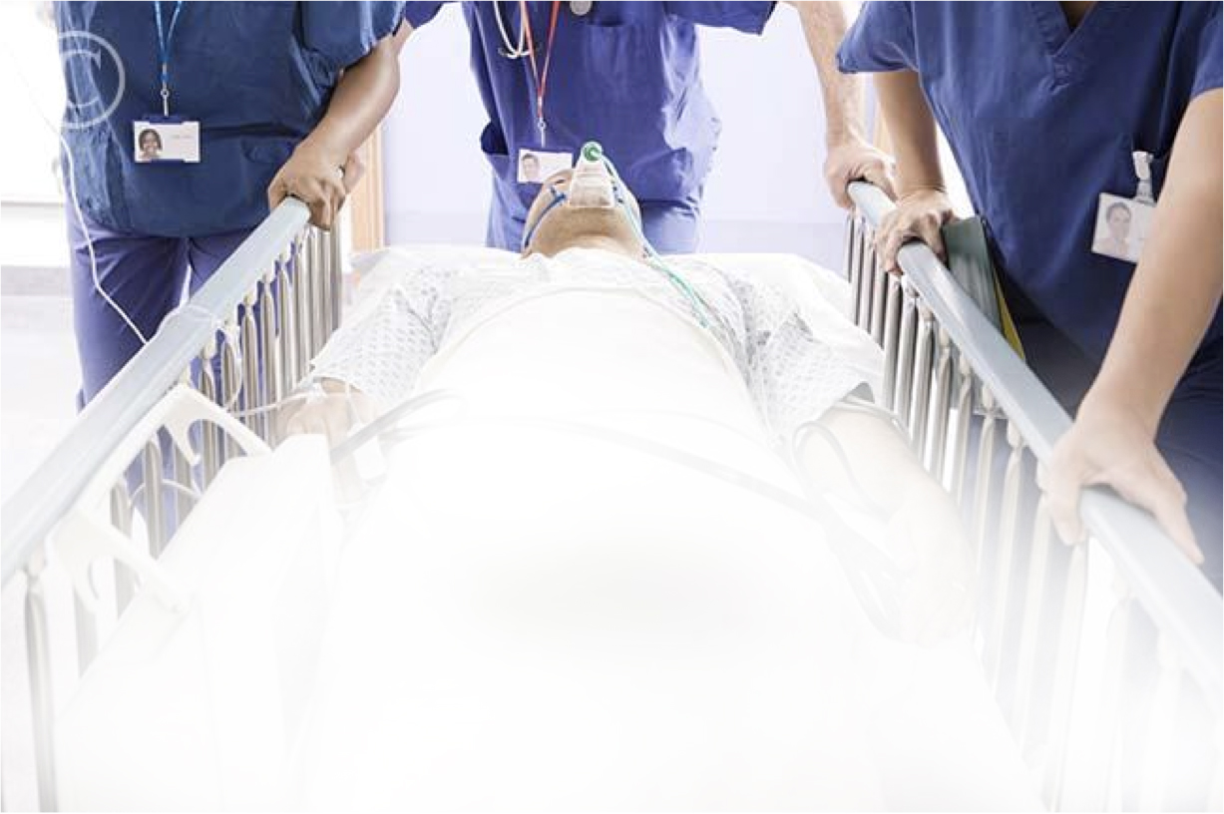
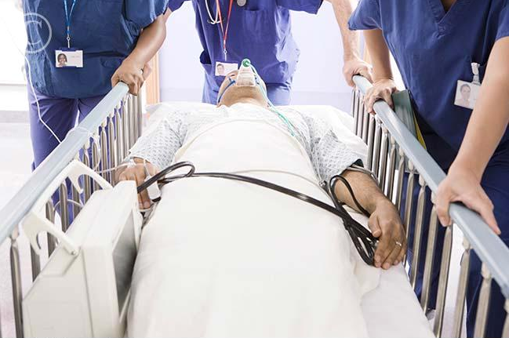
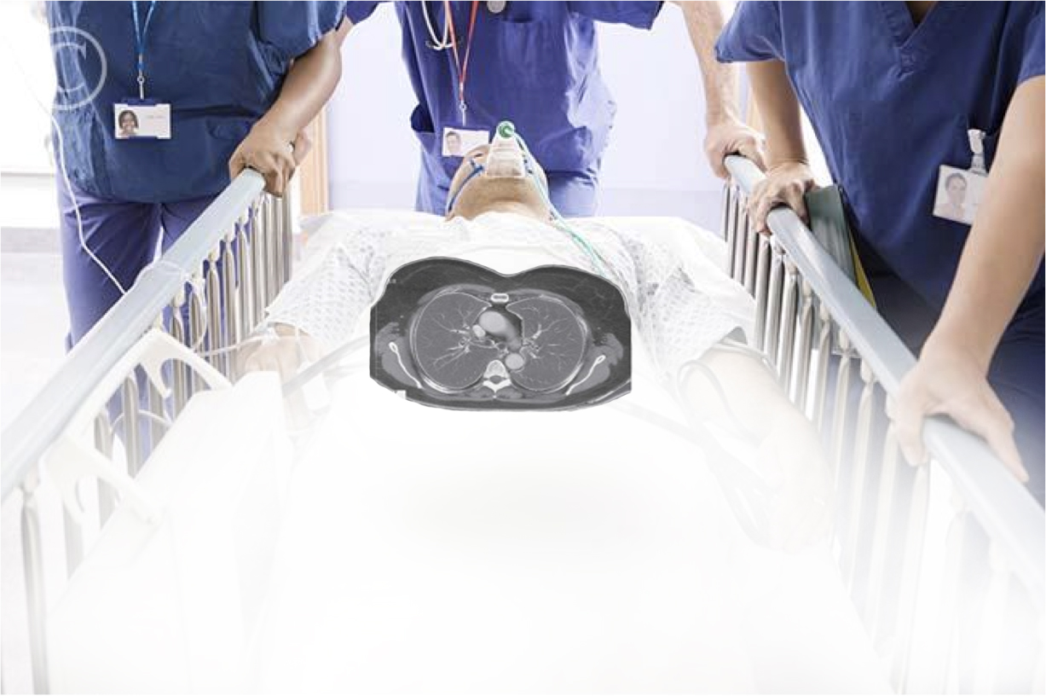
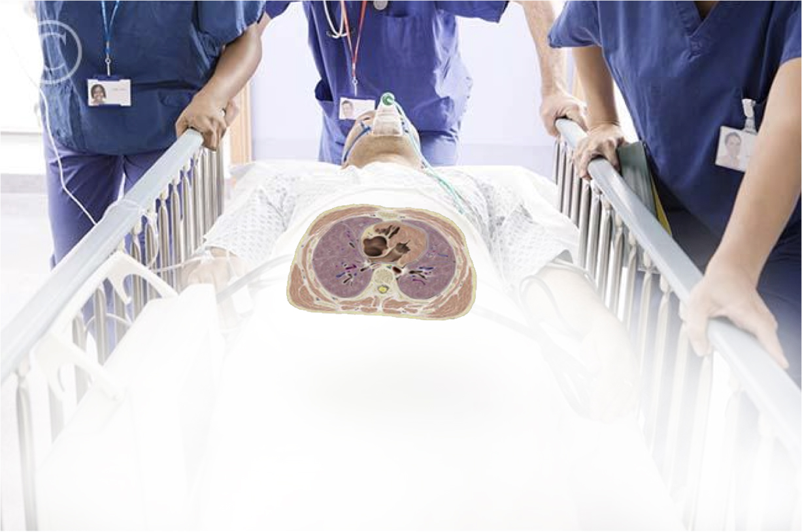
Viewing Cross Sections

Slide 12
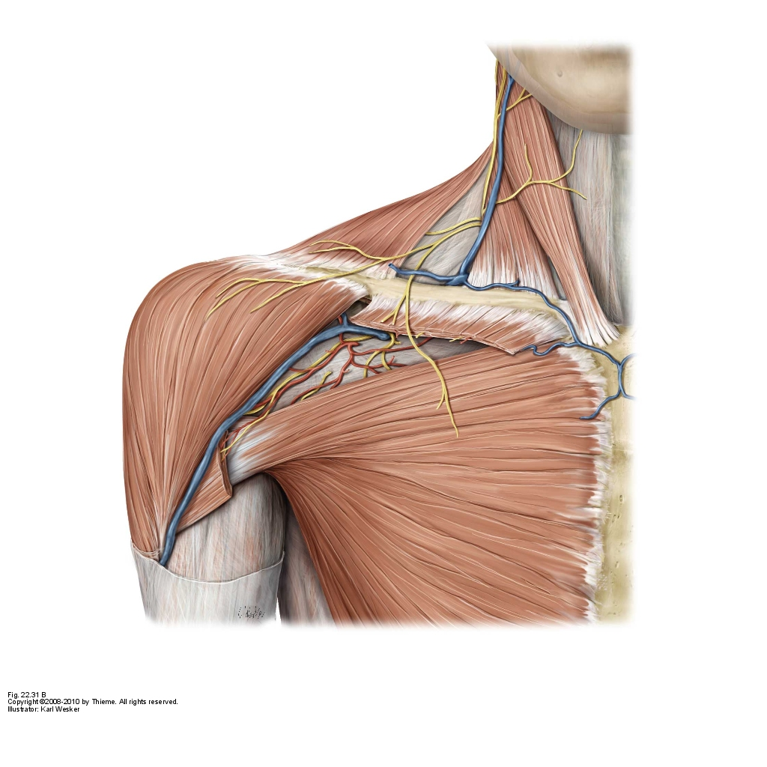
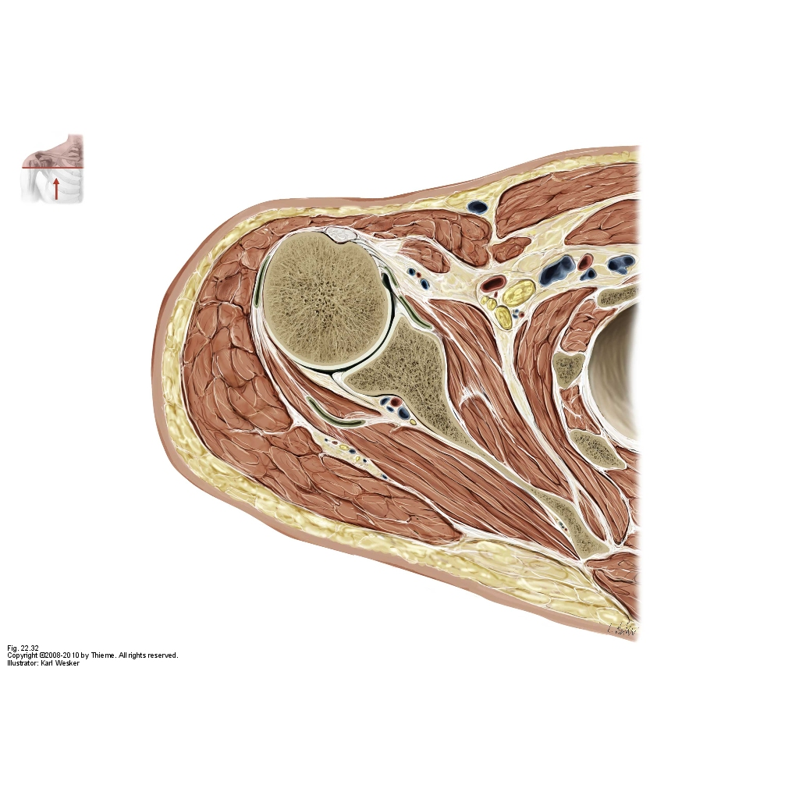
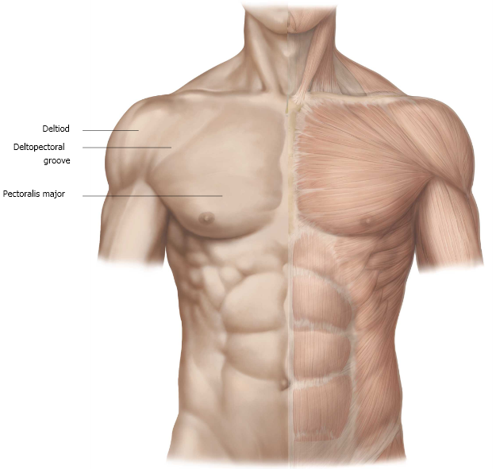
Cross Section of the Shoulder [superficial]

Slide 13
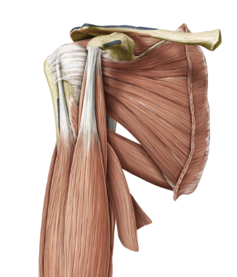
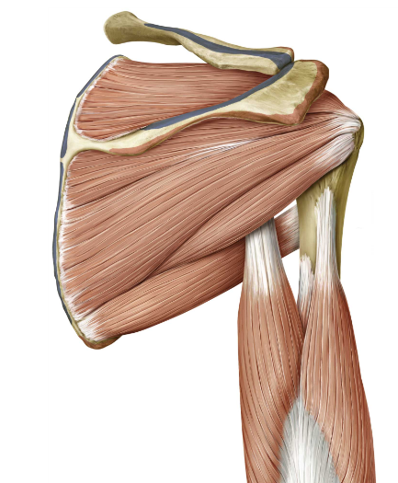
Cross Section of the Shoulder [deep]
Right Shoulder: Anterior View
Right Shoulder:Posterior View

Slide 14
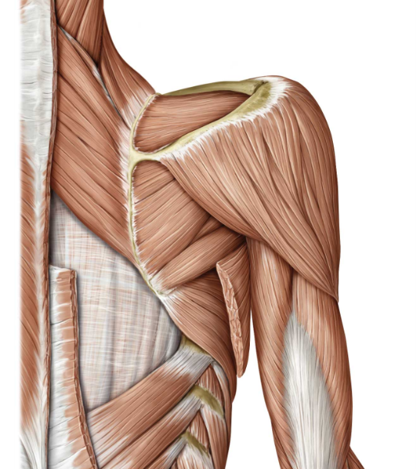
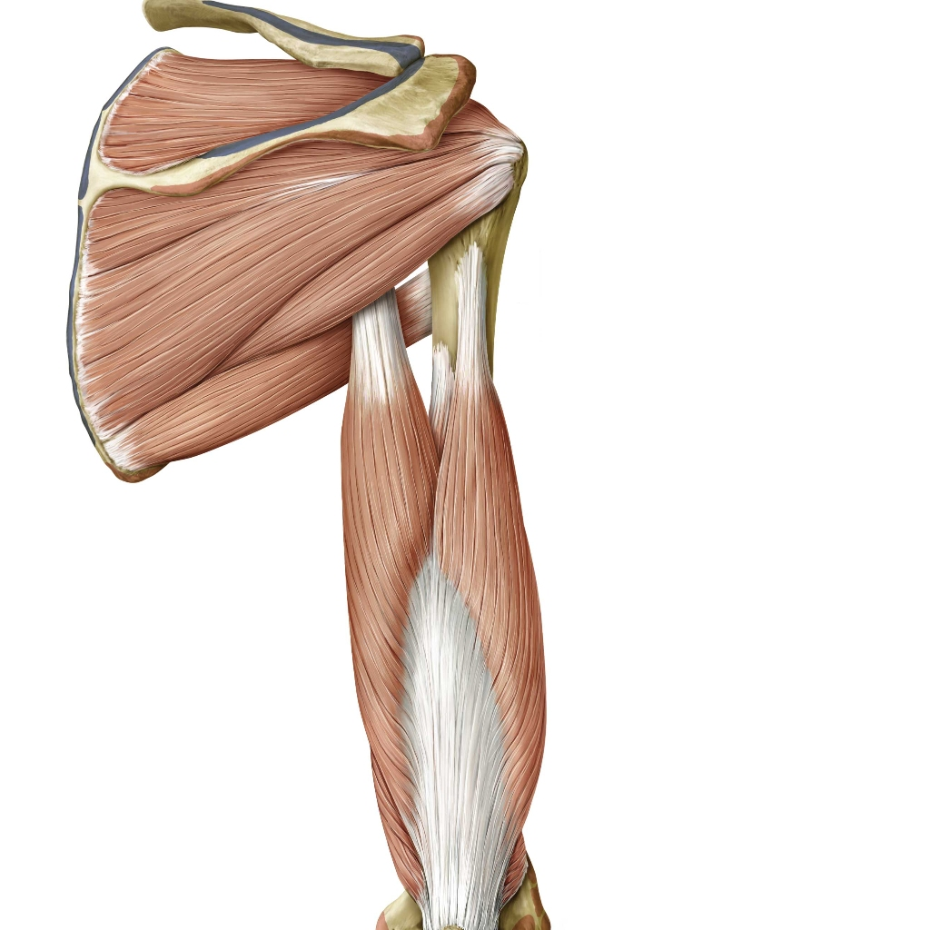

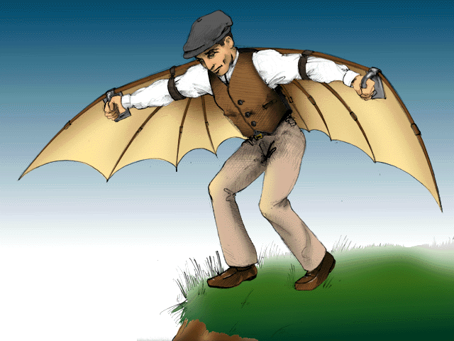
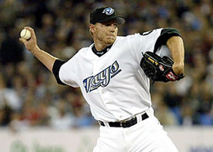
Muscles of the Shoulder:
Deep
Right Shoulder:
Posterior View
Supraspinatus
Teres minor
Three of the four muscles in which make up the rotator cuff are shown: supraspinatus, infraspinatus and teres minor.
Not visible: subscapularis
These four muscles (S.I.T.S.) cross and surround the glenohumeral joint and have a prime function of holding the head of the humerus in the rather shallow glenoid cavity.
Infraspinatus
(1)www.youtube.com/watch?v=R7yfISlGLNU (2)wings.avkids.com/Book/History/Images/wing_man.gif (3) www.thecompletepitcher.com/images/roy_halladay_1.jpg

Slide 15
Muscles of the Shoulder:
Parts of the Deltoid
Right Shoulder:
Posterior View
The deltoid is capable of flexing, medially and laterally rotating, abducting and extending the arm. It is identified by three different portions of the deltiod muscle, each named according to its origin.
Clavicalar part – lateral one third of clavical (not shown)
Acromial part – acromion
Spinal part – scapular spine
The deltoid as a whole is responsible for………..

Slide 16
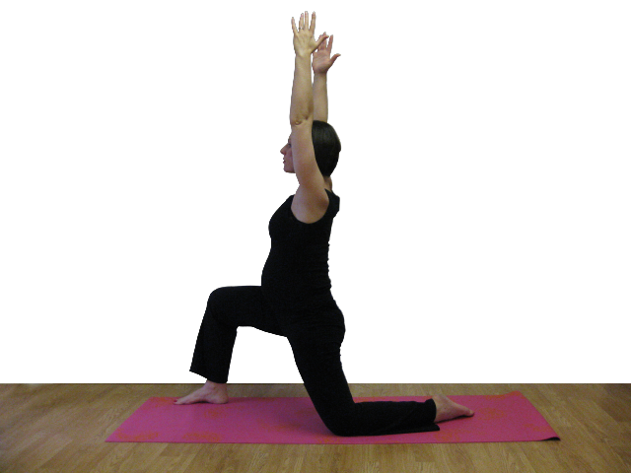
Shoulder: General Range of Motion
Note: the clavical moves greatly with the rotation of the glenohumeral joint.
http://www.pregnancy-yoga.net/wp-content/uploads/2010/09/3-Inhale-Arms-up.png

Slide 17
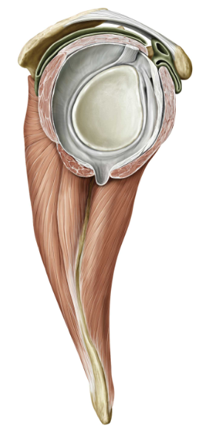
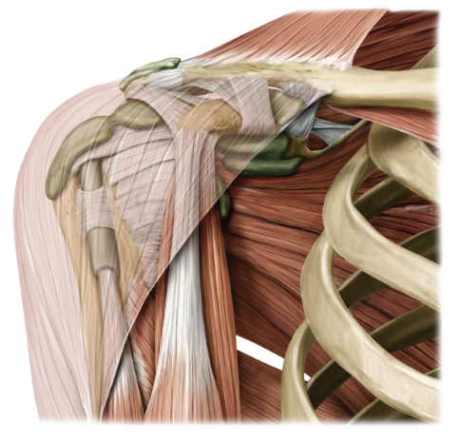
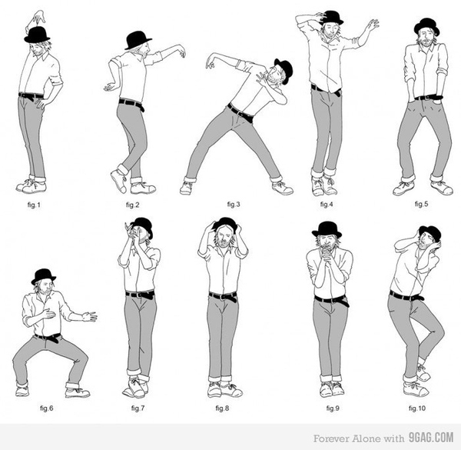
The Shoulder Capsule:
Glenohumeral Joint
The shoulder joint is reinforced by multiple ligaments and muscles, including the S.I.T.S. muscles and the biceps brachii.
The glenoid labrum is a ring that runs around the actual shoulder cavity and deepens joint.
Below are some examples of sholder movements while dancing:
Glenoid labrum
http://www.buzzfeed.com/chrismenning/how-to-dance-like-thom-yorke

Slide 18
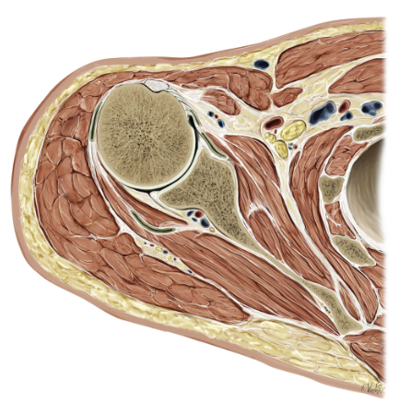
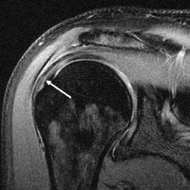
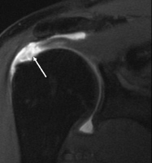
Clinical: The Rotator Cuff
Joints, because of their frequent amount of movement and combination of muscles and ligaments holding them together, injury is common to these supporting structures. Sports demand a large amount of physical strength and mobility from the body and its joints and a person can often overwork or hyperextend joints leading to strain or possible tears.
Injury to the axilary nerve is common with dislocation of the glenohumeral joint.
MRI of healthy shoulder
MRI of completely torn rotator cuff
http://en.wikipedia.org/wiki/Rotator_cuff_tear

Slide 19
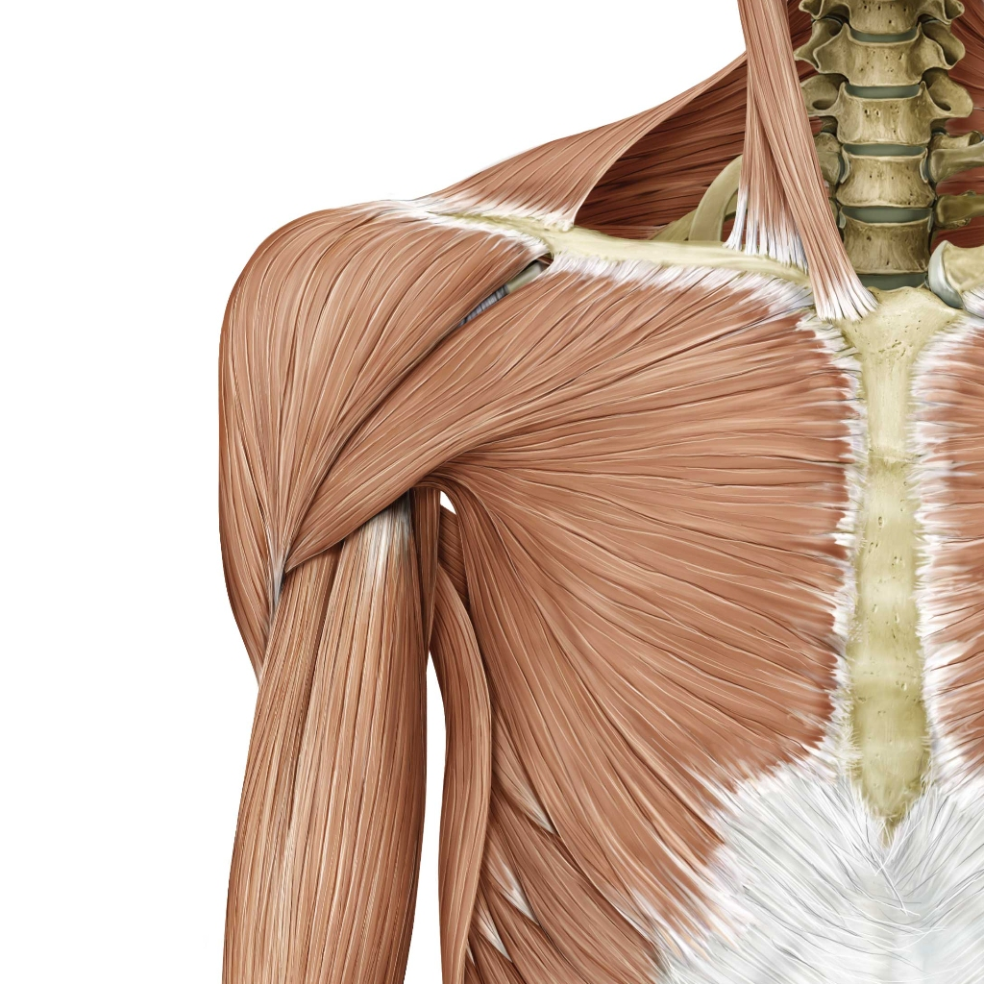
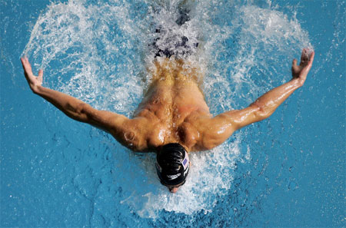
Major Muscles Acting on the Humerus
Pectoralis major
Nine muscles cross the glenohumeral joint and insert on the humerus. Of these particular muscles, the pectoralis major and latissimus dorsi (posterior) serve as prime movers of the humerus.
One major aBductor of the arm is the deltoid. The deltoid muscle originates with the clavicle, scapular spine and acromion, yet the insertion point is on the deltoid tuberosity of the humerus.
With its anterior fibers there is flexion with the shoulder, posterior fibers extend it, and lateral fibers abduct it.
Also, this aBduction by the deltoid is antagonized by the movement of the aDductors, pectoralis major and latissimus dorsi.
Deltoid

Slide 20
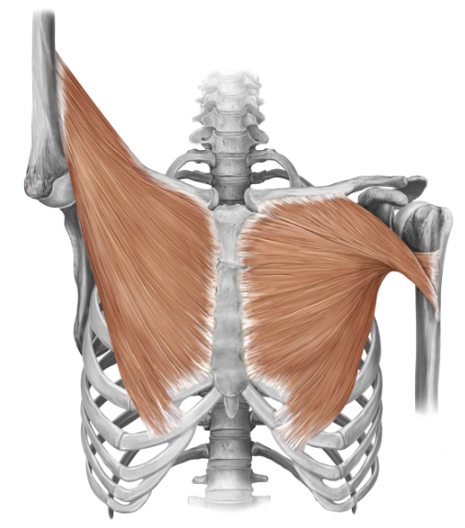
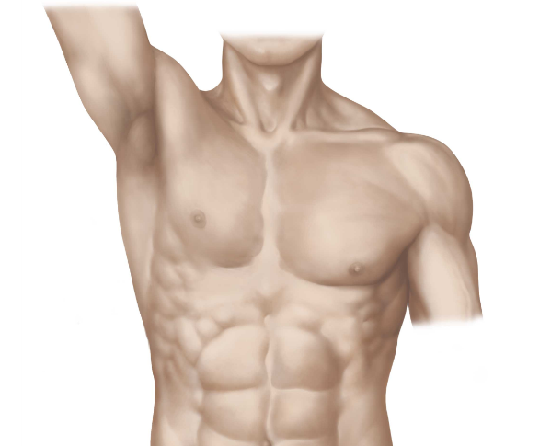
The pectoralis major muscle consists of three parts (clavicular, sternocostal and abdominal) in which cross before inserting on the humerus, resulting in a neutral position when the arm is raised.

Slide 21
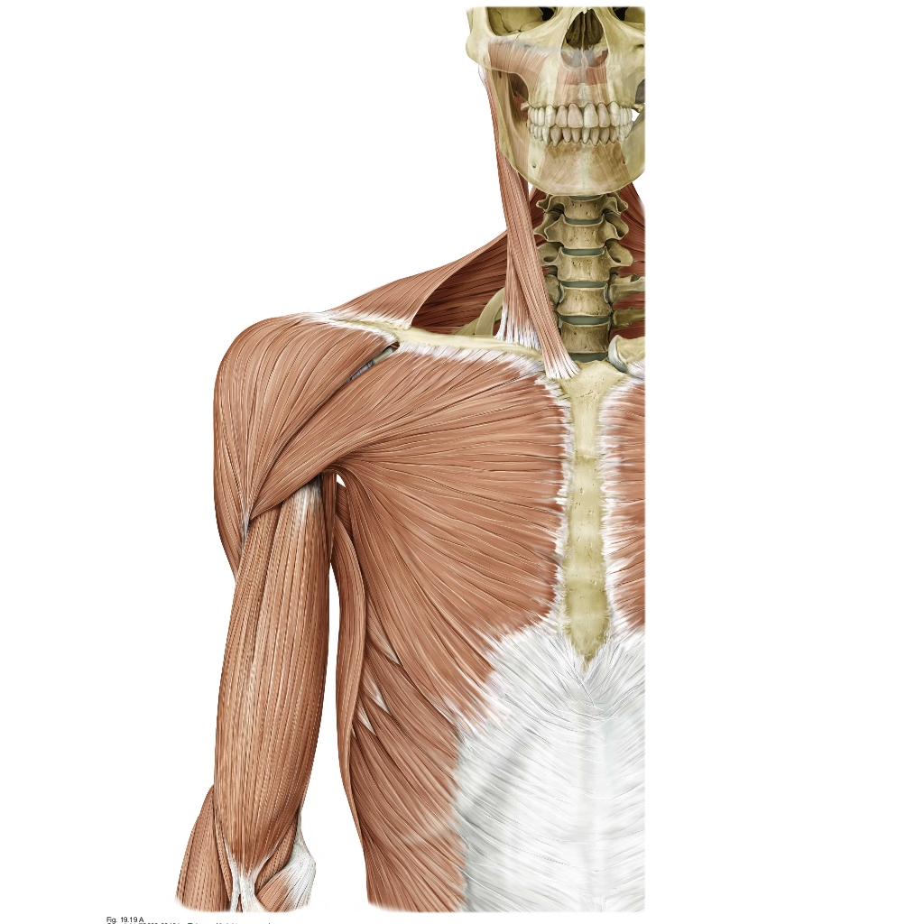
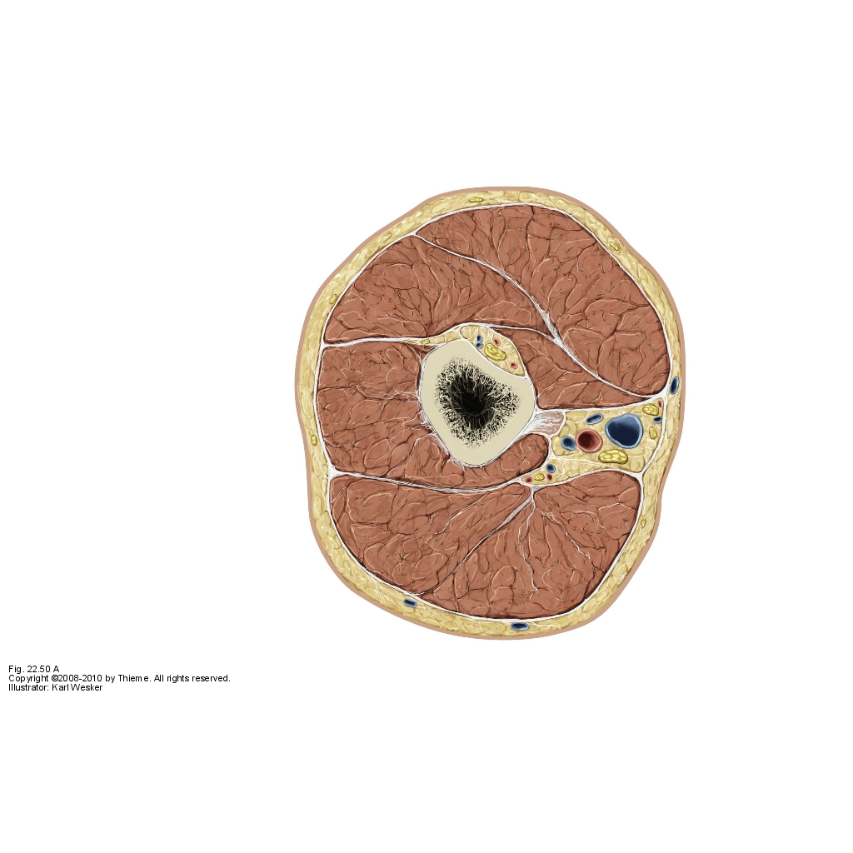
Cross Section of the Arm
Anterior Group
Posterior Group

Slide 22
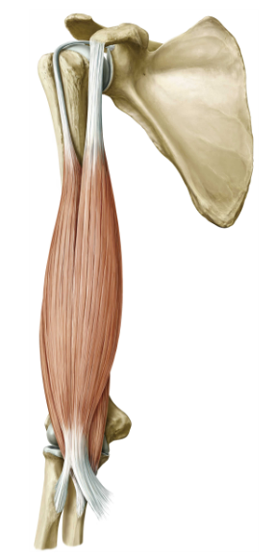
Anterior Muscles of Humerus
Coracoid process
On the left we see a clear view of the biceps brachii. The biceps is named for its two heads, which attach to two separate regions on the scapula.
The tendon of the long head is important in holding the humerus in the glenoid cavity (shoulder joint) and stabilizing the shoulder joint. The two heads converge close to the elbow on a single distal tendon.
The proximal attachment for the biceps brachii (long head) is in the supra-glenoid tubercle, while the short head originates on the coracoid process. The distal attachments for these muscles (detailed later in the forearm module) attaches to the tuberosity of the radius and fascia of the forearm.
Biceps brachii (long head)
What’s in a name ?
Bi = two
Ceps = head
Brachi = arm
Bi + ceps + brachi
Biceps brachii (short head)

Slide 23

Anterior Muscles of Humerus (cont.)
The anterior region is capable of four motions: flexion, extension, pronation, supination.
The biceps brachii is the prime flexor of the forearm at the elbow joint. The brachialis also aids in flexion.
The movement of arm flexion includes these prime movers (biceps brachii and deeper brachialis) on the anterior side of the humerus.
Brachialis

Slide 24
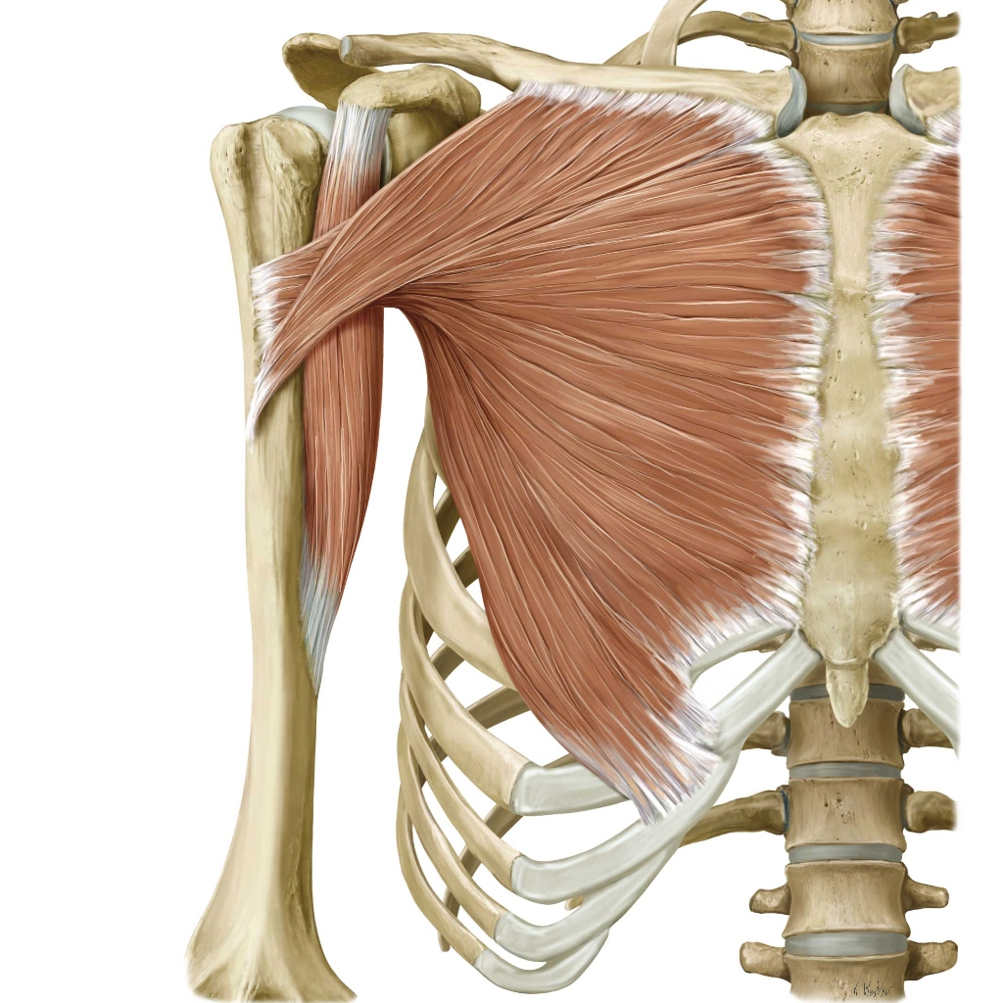
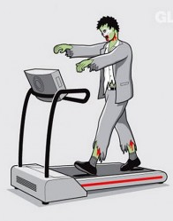
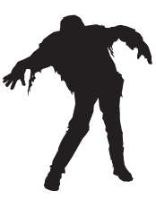
Anterior (deep) Muscles of the Humerus
The coracobrachialis
(COR-uh-co-BRAY-kee-AL-is) is the smallest of the three muscles that attach to the coracoid proces of the scapula. (pectoralis minor and biceps brachii are the other two).
The coracobrachialis draws the humerus forward for shoulder flexion and towards the torso for shoulder adduction. Innervation for this small muscle comes from the Musculocutaneous nerve.
Although a weak flexor and adductor of the arm, the smaller muscles along/within the upper limb help coordinate fine motor movements.
Looking at zombies, they are sure to have well developed coracorachialis and deltoid muscles.
coracorachialis

Slide 25
Posterior muscles of the Arm (deltoid removed)
On the left side we can see the triceps brachii (lateral head and long head) as well as more of the proximal posterior humerus muscles.
The triceps brachii serve as an antagonist muscle group to the biceps brachii. They perform the extension of the arm where as the biceps provide flexion .
Triceps brachii is the main extender of the elbow and inserts on the olcranon of the ulna, yet the three heads all have different origins.
Tricep Head Origins
The long head origin is in the infraglenoid tubercle of the scapula.
The lateral head in the proximal posterior shaft of humerus.
The medial head origin is in the posterior shaft also.
Triceps Brachii

Slide 26
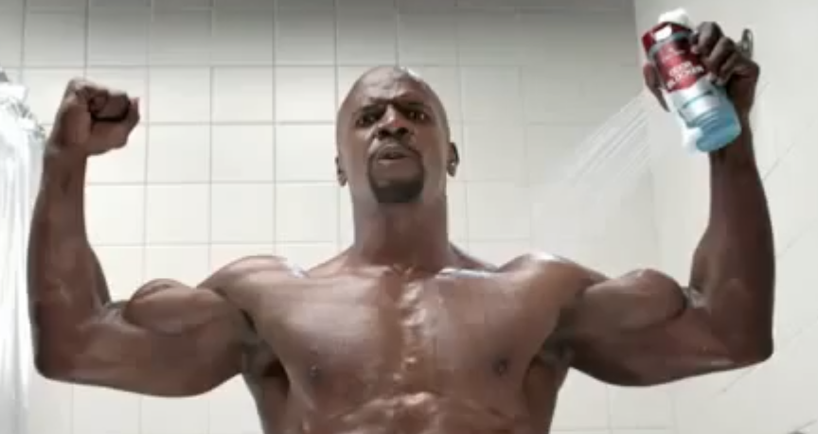
Can you label the muscles?
Biceps brachii:
long and short head
Deltoid
Brachioradialis
Triceps brachii (long head)
Pectoralis major
© Old Spice

Slide 27
Muscles of the Arm
Muscle | Proximal Attachment | Distal Attachment
Deltoid | Scapula, clavicle | Deltoid tuberosity of humerus
Pectoralis Major | Clavicle, sternum | Lateral lip of intertubercular groove
Teres Major | Inferior angle of scapula | Medial lip of intertubercular groove
Coracobrachialis | Coracoid process | Anterior surface of proximal humerus
Supraspinatus | Posterior scapula (supraspinous fossa) | Greater tubercle
Infraspinatus | Posterior scapula (infraspinous fossa)
Teres Minor | Lateral border and posterior surface of scapula
Subscapularis | Anterior surface of scapula (subscapular fossa) | Lesser tubercle
Biceps brachii | Long head – supraglenoid Short head – coracoid | Radial tuberosity

Slide 28
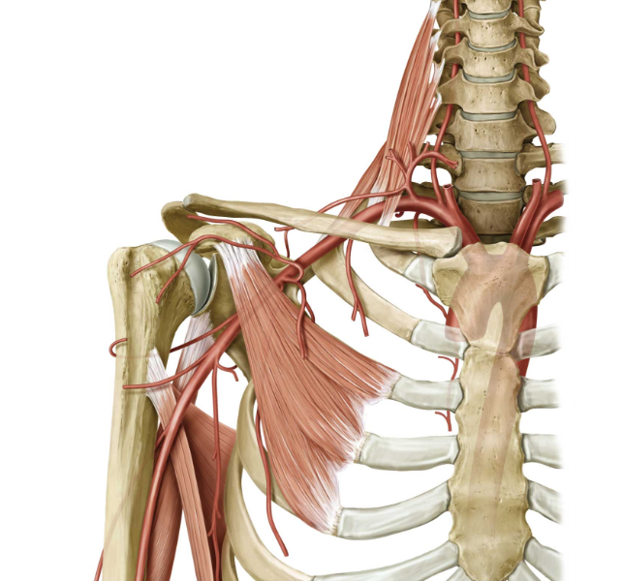
Arterial Supply to the Shoulder:
Axillary Artery
The main source of blood supplied to the shoulder is supplied from the axillary artery. In order to supply the large area around the joint, the artery branches into multiple times. To simplify these branches the axillary artery is separated into three divisions.

Slide 29
Arterial Supply to the Shoulder:
Axillary Artery
1st Division:
- Superior Thoracic Artery
2nd Divison:
- Thoracoacromial Artery
a. Pectoral Branch
b. Deltoid Branch
c. Acromial Branch
- Lateral Thoracic Artery
3rd Division:
- Subscapular Artery
- Anterior Circumflex Humeral Artery
- Posterior Circumflex Humeral Artery

Slide 30
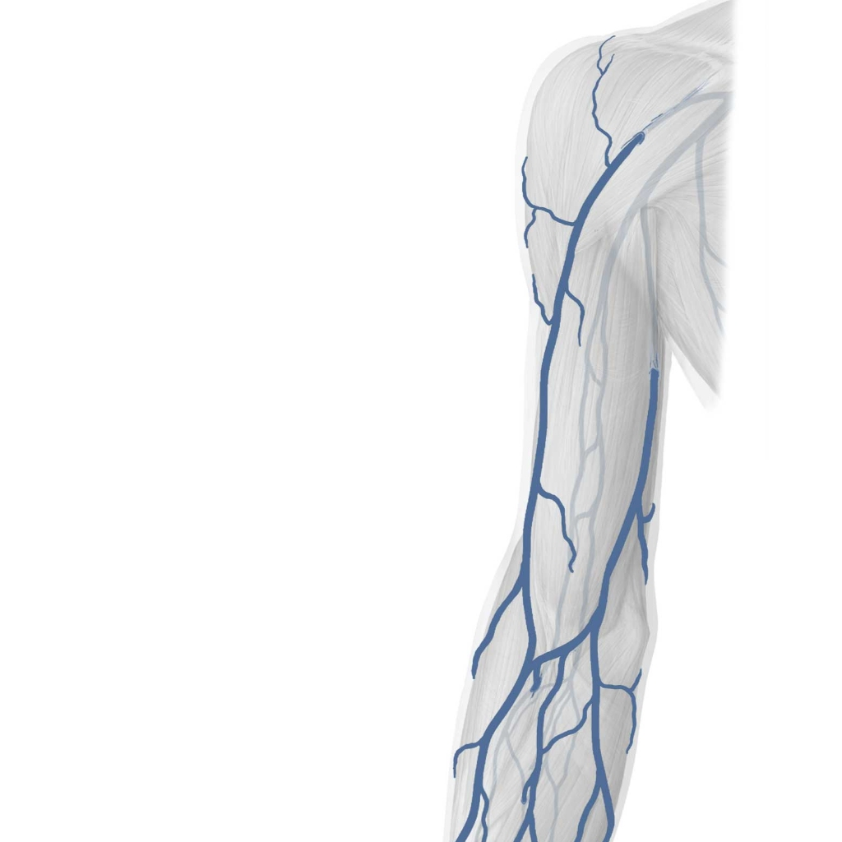
Superficial Venous Drainage of the Upper Limb
The median cubital vein is a short branching between the cephalic and basilic vein that obliquely crosses the cubital fossa (anterior bend of the elbow). This vein is clearly visible through the skin and is the most common site for drawing blood.
Next the basilic vein arises from medial portions of the hand and forearm and travels posteriorly up the forearm, continuing into the brachium. About halfway up the brachium this vein turns deeply into the tissue and runs beside the brachial artery. This basilic haitus is a key area where the vein perforates the deep tissue.
The cephalic vein arises from lateral portions of the hand and forearm, and travels up the forearm. Then it continues up the lateral aspect of the brachium to the shoulder and joins the axillary vein there. IV fluids are often administered distally in this vein.
Cephalic v.
Basilic hiatus
Median cubital v.
Basilic v.

Slide 31
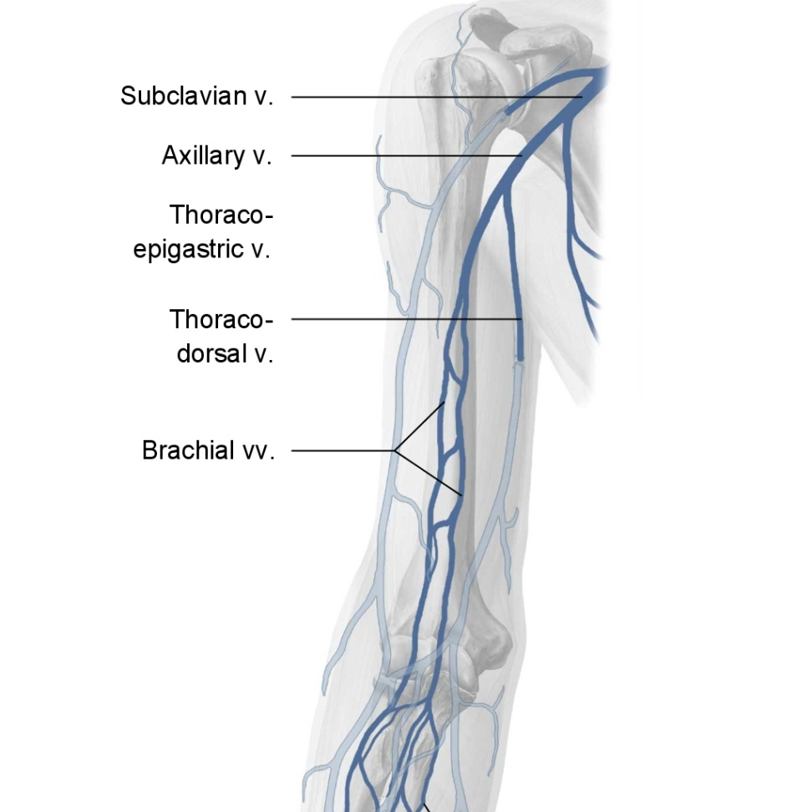
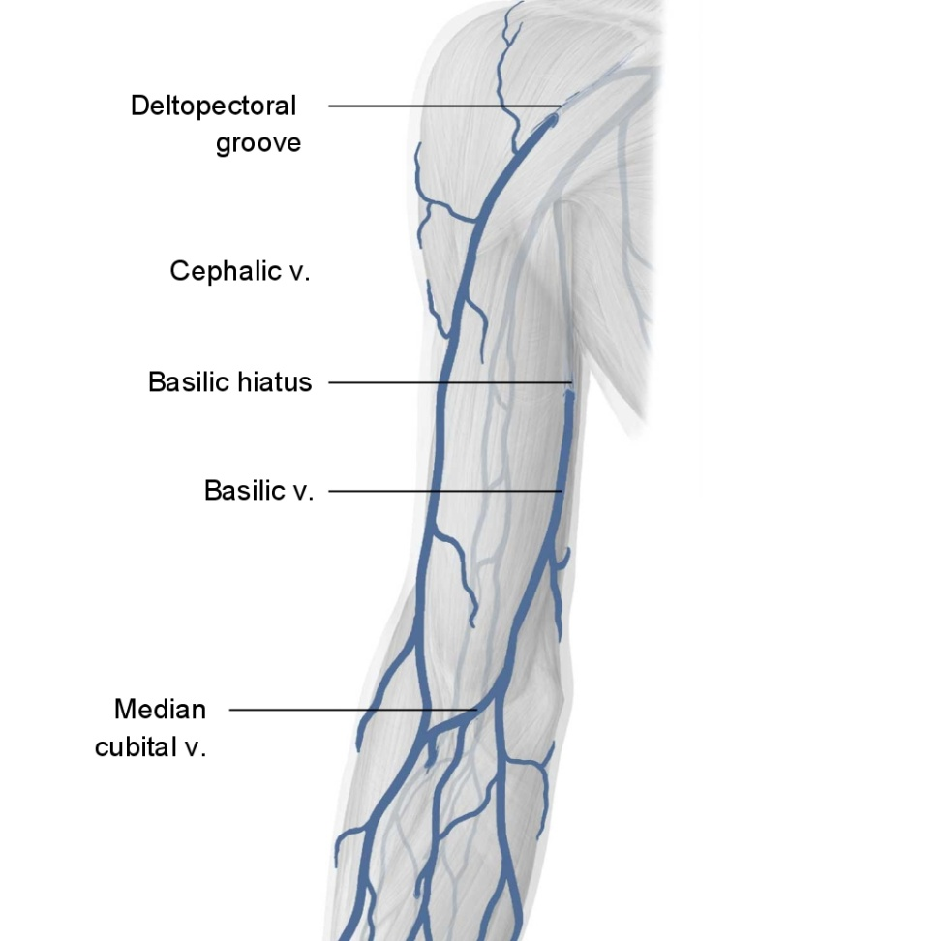
Deep Veins vs. Superficial Veins

Slide 32
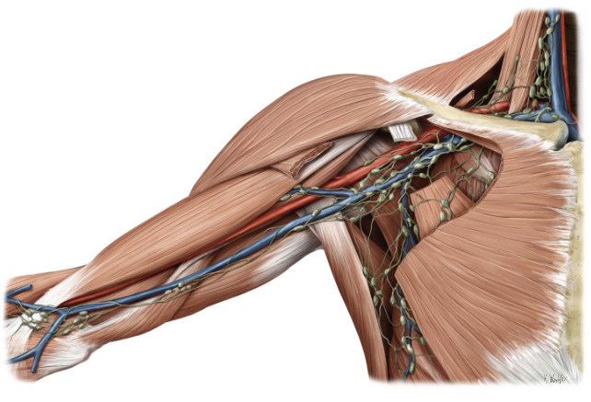
Lymphatic system for the Arm

Slide 33
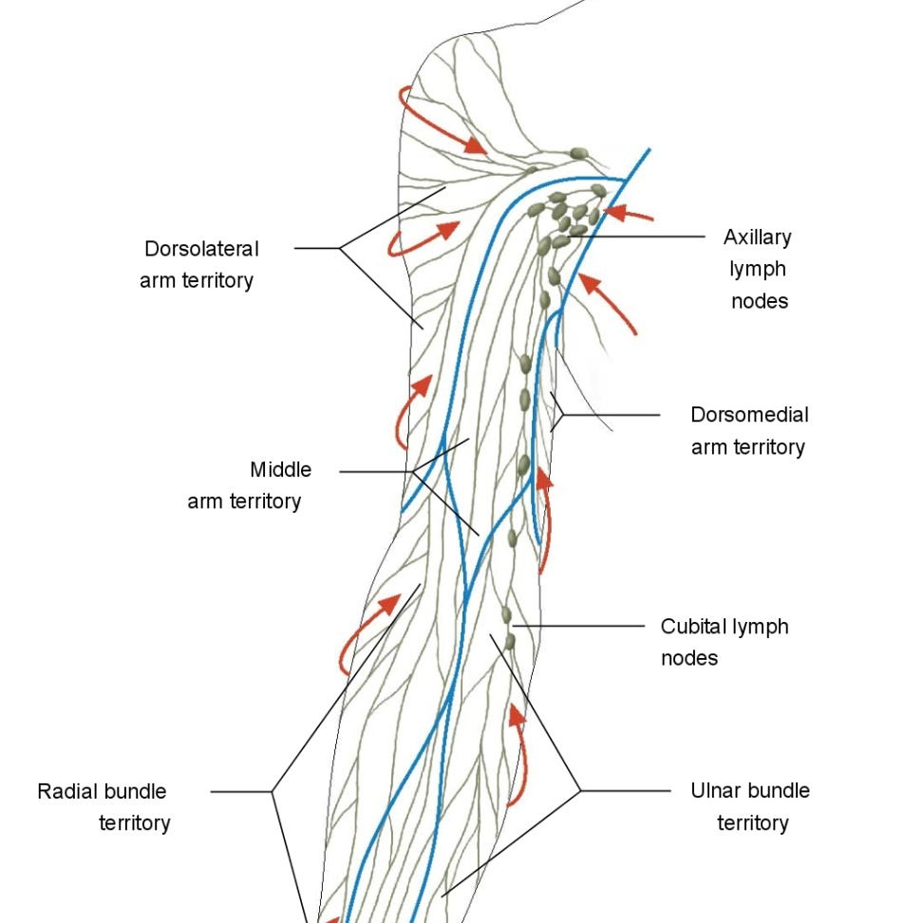
Lymphatic system for the Arm
Lymph from the upper limb and breast drains to the axillary lymph nodes. The superficial lymphatics of the upper limb lie in the subcutaneous tissue. Also, the deep lymphatics accompany the arteries and deep veins.
Notice the red arrows pictured on the left. These arrows show the flow of lymph. Notice that the flow of lymph follows the same direction as the venous drainage of the arm.
Question: WHAT EXACTLY IS THE LYMPHATIC SYSTEM? & WHAT DOES IT DO? (answer, next slide)

Slide 34
Lymphatic system for the Arm
Lymphatic system is a network of tissues and vessels that help to maintain the body’s fluid balance, cleanse the body of foreign matter, and provide immune cells for defense.
Lymph is the fluid that the system collects from the interstitial spaces of the tissues and returns to the bloodstream. (Fluid continually filters from out blood capillaries into the tissue spaces. The blood capillaries reabsorb most of it, but there is a small percentage they do not. The lymph system collects this mix of fluids and proteins to return the substances back to the blood.
Also the lymph nodes contain white blood cells and other mechanisms for the body to fight off pathogens – this also creates a type of ‘filter’ for the body against harmful fluids or disease causing agents in the blood.

Slide 35
The Forearm
The forearm is composed of the radius and ulna.
The forearm is much more constricted in comparison to the range of motion of the arm. The primary function of the muscles in the forearm is movement of the bones in the hand. Bound together by the interosseous membrane, the radius and ulna are virtually immobile.
We will begin understanding the forearm by covering the surface anatomy of the radius and ulna.

Slide 36
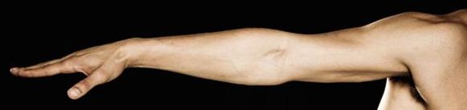
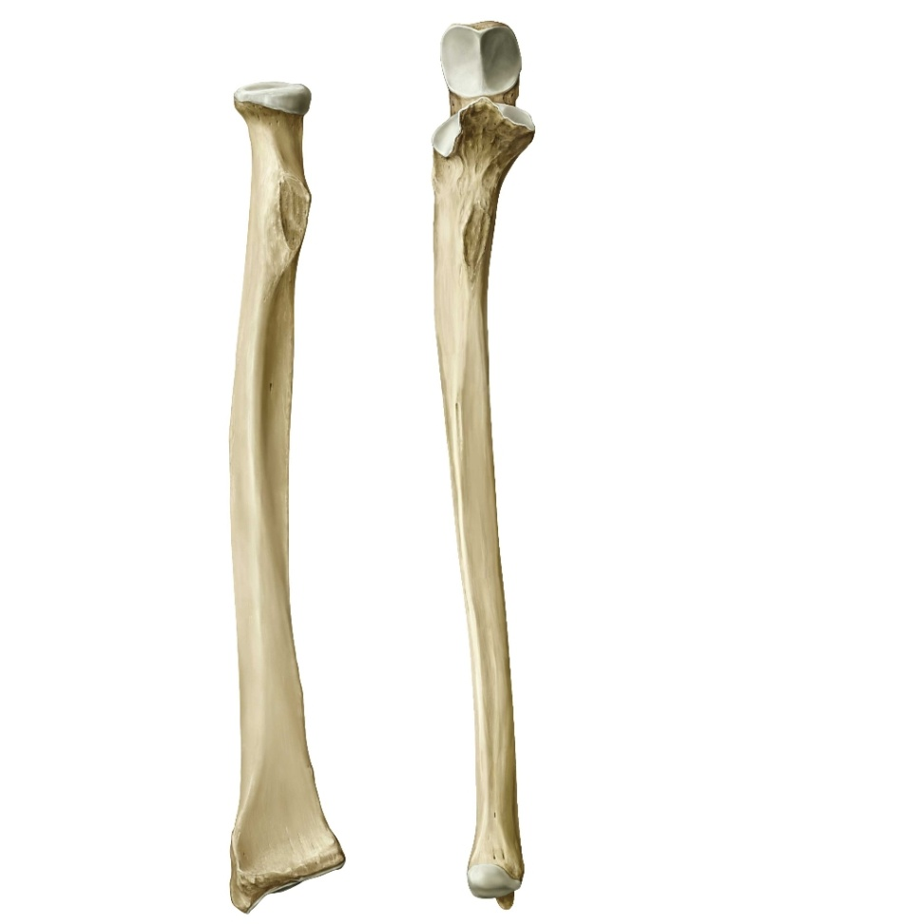
Bones of the Forearm
The antebrachium (or forearm), extends from elbow to wrist and contains two bones (pictured on right).
The radius and the ulna. In anatomical position, these bones are parallel and the radius is lateral to the ulna (also called supination). However during other times the radius and ulna overlap and rotate against one another (called pronation).
We will discuss supination and pronation later. First, simply recognize that the forearm has two bones. Also recognize that as we move in a distally along the upper limb, the bones and musculature become more numerous and complex.
Radius
Ulna
Proximal
Distal
http://www.visualphotos.com/image/2x3876888/bare-chested_man_with_arm_outstretched

Slide 37
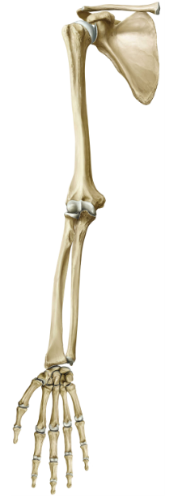
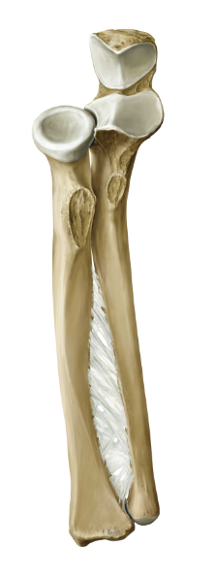
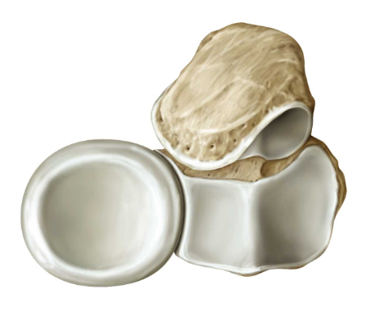
Radius and Ulna: Proximal View
Right Shoulder:
Anterior View
The proximal head of the radius is a distinctive disc with an articular fovea that helps with free rotation on the humerus and ulna during pronation to supination (explained later in module).
This proximal head also articulates with the capitulum of the humerus and radial notch of the ulna.
Dorsal
Ventral

Slide 38
Radius and Ulna: Proximal View
Right Shoulder:
Anterior View
On the radius shaft, immediately distal to the head, is a medial rough radial tuberosity, which is the insertion of the biceps muscle. Each bone had a tuberosity segment protruding from the proximal region which is an prime source for muscle attachment (discussed later).
Dorsal
Ventral

Slide 39
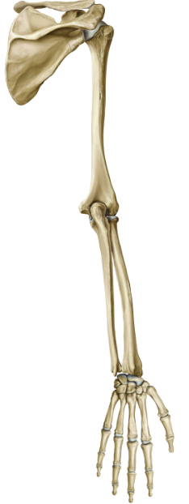
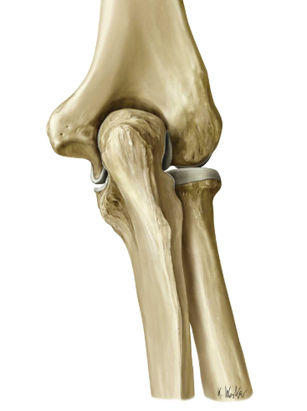
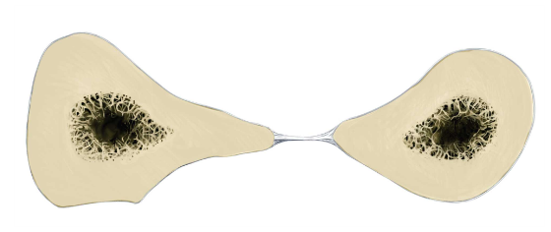
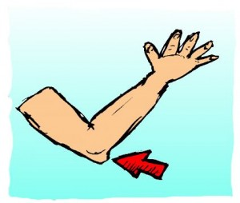
Radius and Ulna: Proximal View
Right Shoulder:
Posterior View
The proximal side end of the ulna contains a process large process known as the olecranon. The olecranon articulates with the olecranon process of the humerus and is the palipable bone in which people commonly refer to solely as their ‘elbow’.
The radius and ulna are held together by a fibrous membrane known as the interosseous membrane.
Dorsal
Olecranon
Interosseous membrane
Ventral
http://ivfgirl.com/miss-pointy-elbow/

Slide 40


Radius and Ulna: Distal View
Right Wrist:
Posterior View
The distal end of the radius and ulna meet the carpal bones of the hand to form the wrist. The radius provides a major carpal articular surface in which the carpals articulate.
Note that both the radius and the ulna have bony prominences known as styloid processes. The styloid process of the ulna is what most refer to at the ‘wrist bone’.
Radius
Ulna
Carpal articular surface
Styloid process of radius
Styloid process of ulna
Image Source: http://www.zazzle.com/praying_hands_sculpture_photosculpture-153484763857617297

Slide 41

The Elbow
Next, we will be looking at a series of slides which detail the elbow joint.
Although we have been viewing the articulation of the radius and ulna with the humerus (as shown on the left), it is important to also take note of the ligaments surrounding these bone.
The ligaments of the elbow bring stability to the joint and attach securely from one bone to the next.
The ulnar collateral & radial collateral ligament, as well as the annular ligament will be our focus (pictured next).

Slide 42


The Elbow: Stability
The major ligaments we will detail are shown on the right.
The ulnar collateral ligament is part of the humeroulnar joint. This ligament articulates with the trochlea and trochlear notch of the ulna.
The radial collateral ligament shown is part of the humeroradial joint. This ligament articulates with the capitellum and articular fovea of the radius.
The annular ligament is part of the proximal radioulnar joint. This ligament articulates with the radial notch of the ulna and the radius (articular circumference).

Slide 43




The Elbow: Movement
Right Forearm: Anterior View
In supination the palm is facing upward, bones are parallel, an easy way to remember this type of palm orientation is to think of “holding out your hand to receive a cup of soup”.
For pronation, the palm is facing downward. The radius rotates over the ulna and bones are no longer in a strict parallel fashion. To remember this motion think of a basketball player in the NBA – because a “pro basketball player dribbles with his palm downward.”
Supination
Beyoncé: “Put A Ring On It”
Pronation

Slide 44

FYI: Hypermobility (a.k.a. Being Double Jointed)
Someone who is “double jointed” is capable of stretching and repositioning their bones within their joints much more than the average person.
Possible causes:
Abnormally shaped or misaligned bones and joints
Abnormally soft connective tissue such as Type 1 collagen
Hypermobility is often linked with osteoarthritis in later years of life due to the increased rate of deterioration of the joints.

Slide 45


Right Forearm:
Anterior View
Cross Section of the Arm
Posterior Compartment
Anterior Compartment
Posterior Compartment: Radialis Muscles

Slide 46



Layers of Forearm Muscle
Superficial
Intermediate
Deep
Now that we have looked at the bones and ligaments of the forearm and elbow, we turn our attention to the musculature of the forearm. Take note that the forearm has three general compartment layers or levels of muscle. Each of these layers is pictured above.
The superficial, intermediate, and deep layers are all found close to one another. In the next slides we will detail each of these groups of muscles with their organization and function.

Slide 47

Muscles of the Forearm: Anterior
[Superficial]
Right Fprearm:
Anterior View
Most of the muscles of the anterior compartment are flexors of the wrist and fingers. These muscles arise proximally from the medial epicondyle. The two prominent tendons that you can palpate at the wrist belong to the palmarus longus and the flexor carpi radialis.
The flexor carpi radialis is an important landmark for finding the radial artery, where the pulse is usually taken.
The pronator teres muscle pronates the forearm and flexes the elbow.
Flexor carpi ulnaris flexes and aDducts the wrist; and fixes the writst during extension of the fingers.
Did You Know (?) The palmarus longus is absent in about 14% of the population. To see if you have one, flex your wrist and touch the tips of your thumb and little finger together. If present, the palmarus longus tendon will stand up prominently on the wrist.
Palmaris longus
Pronator teres
Flexor carpi radialis
Flexor carpi ulnaris

Slide 48


Muscles of the Forearm: Anterior
[Intermediate]
Right Fprearm:
Anterior View
Flexor digitorum superficialis flexes the fingers II – V at proximal interphalangeal joints; aids in flexion of wrist at the metacarpohalangeal joints.
Flexor digitorum superficialis
Insertion:

Slide 49


Muscles of the Forearm: Anterior
[Deep]
Right Fprearm:
Anterior View
Attached to the most proximmal joints in the hand (PIP), these muscles serve as the primary strength in a person’s fingers when gripping objects such as rock walls.
Flexor digitorum profundus
Insertion:
Flexor pollicis longus
Pronator quadratus

Slide 50

Muscles of the Forearm: Posterior
[Radialis Muscles]
Right Fprearm:
Right Lateral View
On the left we see a helpful lateral view of the radialis group muscles of the forearm. These large forearm muscles enable powerful elbow flexion. They all arise from the lateral epicondyle.
Each of these forearm muscles is used slightly differently in varying degree towards moving the elbow for flexion.
Besides flexion of the elbow:
Brachioradialis acts towards semipronation.
Extensor carpi radialis longus
Extensor carpi radialis brevis help with wrist extension and aBduction.
brachioradialis
Extensor carpi radialis longus
Extensor carpi radialis brevis

Slide 51

Muscles of the Forearm: Posterior
[Suprficial]
Right Fprearm:
Posterior View
Extensor carpi ulnaris forearm muscle extends and aDducts the wrist.
Extensor Digitorum extends the II - V fingers at metacarpophalangeal joints and also serves to extend the wrist.
Extensor digiti minimi forearm muscle is sometimes considered to be a detached portion of extensor digitorum. This muscle extends the metacarpophalageal joint of the little finger.
Extensor digitorum
Extensor carpi ulnaris
Extensor digiti minimi

Slide 52

Muscles of the Forearm: Posterior
[Deep]
Right Fprearm:
Posterior View
Supinator this muscle is aptly named because it is what supinates the forearm.
aBductor pollicis longus serves to aBduct and extends the thumb; aBducts the wrist.
Extensor pollicis longus will extend the thumb at the metacarpophalangeal joint.
Extensor indicis will extend the index finger at the metacarpophalangeal joint.
Supinator
Extensor pollicis longus
Abductor pollicis longus
Extensor indicis

Slide 53
Anterior Forearm Compartment
Superficial Muscle Group | Proximal Attachment | Distal Attachment
Pronator teres | Medial epicondyle | Radial Shaft
Flexor carpi radialis |  | Metacarpals (radial side of wrist)
Palmaris longus |  | Palmar aponeurosis
Flexor carpi ulnaris |  | Carpals (ulnar side of wrist)
Intermediate muscle | Proximal Attachment | Distal Attachment
Flexor digitorum superficialis | Medial epicondyle, superior half of radius | Middle phalanges of digits II-V
Deep Muscle Group | Proximal Attachment | Distal Attachment
Flexor digitorum profundus | Proximal ulna and interosseous membrane | Distal phalanges of digits II-V
Flexor pollicis longus | Radius and interosseous membrane | Distal phalanx of digit I
Pronator quadratus | Distal ulnar shaft | Distal radial shaft

Slide 54
Posterior Forearm Compartment
Superficial group | Proximal Attachment | Distal Attachment
Extensor digitorum | Lateral epicondyle | Distal phalanx of digits II-V
Extensor digiti minimi |  | Distal phalanx of digit V
Extensor carpi ulnaris |  | Base of metacarpals on ulnar side
Deep group | Proximal Attachment | Distal Attachment
Supinator | Lateral epicondyle | Proximal radial shaft
Abductor pollicis longus | Posterior radius and ulna | Base of 1st metacarpal
Extensor pollicis brevis | Posterior radius | Proximal phalanx digit I
Extensor pollicis longus | Posterior ulna | Distal phalanx of digit I
Extensor indicis |  | Middle and distal phalanges of digit II

Slide 55

Arterial Supply to the Forearm
On the right we can see that just distal to the elbow, the brachial artery divides into the radial artery and the ulnar artery. These arteries travel alongside the radius and ulna respectively.
The most common place to take a pulse is at the radial artery, just proximal to the thumb. Near its origin, the radial artery receives the deep brachial artery.
STRUCTURES SUPPLIED BY THESE ARTERIES:
Radial artery: supplies the lateral forearm muscles, wrist, thumb, and index finger.
Ulnar artery: supplies the medial forearm muscles, digits III – V, and the medial aspect of the index finger.
Radial artery
Ulnar artery

Slide 56

Posterior (Dorsal) View of Deep Arterial Supply
Anterior interosseous artery (on opposite side of interosseous membrane pictured on previous slide)
On the previous slide we took note of how the radial artery and the ulnar artery traveled along the respective bones from which they are named.
Here we can see the arterial supply that runs between the bones of the forearm.
The ulnar artery near its origin give rise to the anterior and posterior interosseous arteries. These arteries travel between the radius and ulna.
STRUCTURES SUPPLIED BY THESE ARTERIES:
1. Interosseous arties supply the deep flexors and extensors of the forearm.
Posterior interosseous artery

Slide 57

The Cubital Fossa
Biceps brachii
On the left we have a clear view of the cubital fossa and the bicipital aponeurosis. However, we must also recognize the boundaries of the fossa.
The boundary of the cubital fossa is in a triangular shape and consists of three muscle groups.
These three muscles that form this triangular bounday are: the brachioradialis (laterally) and pronator teres (medially).
Brachioradialis
Pronator teres
Bicipital aponeurosis

Slide 58



Veins of the Forearm often have differences in their network: Cubital Fossa: Variant Anatomy
Accessory cephalic vein structure
M-Shaped structure
Absent median cubital vein

Slide 59



Clinical: Venipuncture
The bicipital aponeurosis (lacertus fibrosis) aponeruosis or broad band of fascia is located in the cubital fossa a serves as a divider that separates the superficial and deep structures of the fossa.
The median cubital vein (common site for drawing blood) runs directly over this aponeurosis which serves as a “floor” or basement layer for taking blood.
http://www.tpub.com/corpsman/227.htm

Slide 60

Superficial Venous Drainage of the Forearm
Basilic vein
Cephalic vein
Superficial veins easily seen through the skin of most people and are larger in diameter than the deep veins.
Cephalic vein arises from the lateral side of the dorsal venous arch, winds around the radius as it travels up the forearm. (IV fluids often administered here).
Basilic vein arises from the medial side of the dorsal venous arch, travels the posterior aspect of the forearm.
Median Cubital Vein is a short bridge between the cephalic and basilic vein that obliquely crosses the cubital fossa.
Median Antebrachial vein originates near the base of the thumb, then it will travel up the forearm between the radial and ulnar veins.
Median cubital vein
Median antebrachial vein

Slide 61

Deep Venous Drainage of the Forearm
On the left we can see a faint blue outline of the superficial venous drainage. However, the darker blue color veins shows a clear pathway that the deep veins use to drain the forearm.
The radial vein receives blood from the lateral side of both palmar arches and courses up the forearm along the radius.
The ulnar vein receives blood from the medial side of both palmar arches and then travels up the forearm by the ulna.
Anterior interosseus vein this vein receives blood from the deep tissues of the forearm and courses upward between the radius and ulna.
Radial vein
Ulnar vein
Anterior interosseous vein

Slide 62
Lymphatic system for the Arm
Lymph from the upper limb and breast drains to the axillary lymph nodes. The superficial lymphatics of the upper limb lie in the subcutaneous tissue. Also, the deep lymphatics accompany the arteries and deep veins.
Notice the red arrows pictured on the left. These arrows show the flow of lymph. Notice that the flow of lymph follows the same direction as the venous drainage of the arm (see arm module for greater detail).
The majority of lymph nodes for the upper limb are found in the axillary (arm pit) region. The lymph from the forearm also drains upward toward these structures.

Slide 63
The Hand
The upper limb in subdivided into three regions: arm, forearm, and hand.
These regions comprise the entire upper limb, which is attached to the body at the pectoral girdle.
We will take an in-depth look at each of these three distinct upper limb regions. Let’s continue by understanding the structure and function of the hand/wrist.

Slide 64


The Wrist & Hand
There human hand is essential to daily life and performs a wide range of tasks. Thus the anatomy and organization of the hand is one of the most unique areas of the body.
The hand needs to be mobile to position the thumb and fingers. Also, the hand must be able to perform fine-motor movements and maintain precision. The wrist / hand is fascinating.
In this module we will outline the 27 bones that compose the wrist and hand. We will also take a look at the ligaments, muscles, and vasculature of the wrist & hand.
Fingertip
Hand Structure

Slide 65

Bone Organization:
The bones of the hand are arranged in three distict regions (shown on right).
The carpal bones make up the wrist. These bones are relatively short and allow up and down, and side to side movements of the wrist. Also, note that these bones are arranged in two rows of four bones each.
Metacarpals are the bones which form the palm. On a skeleton, these bones look almost like finger extensions – this causes x-ray images of the hand to display fingers as much longer than they really are.
The most distal region of hand bones are the phalanges. These are the bones of the fingers. Notice the three separate levels of bone for this region. As a result, phalanges can be identified by Roman numerals preceded by proximal, middle and distal.

Slide 66

The carpal bones (dorsal view)
Capitate
Hamate
Triquetrum
Trapezium
Lunate
Trapezoid
Scaphoid

Slide 67

The Carpal Bones (palmar view)
Trapezium
(tubercle of trapezium)
Hamate
(hook of hamate)
Trapezoid
Pisiform
(*not visible on dorsal view)
Capitate
Triquetrum
Scaphoid
Lunate

Slide 68

Bones of the Hand: Metacarpals
The metacarpals and phalanges have three distinct regions including a head, shaft, and base as distinguished sites.
Some of the muscles that attach on these bones include the flexor pollicis brevis, opponens pollicis, and oppenens digiti minimi (discussed later).

Slide 69


Bones of the Hand: Philanges
The philanges of the hand, like the philanges of the foot, contain a proximal, middle and distal bone. The thumb and the first digit of the toe are exceptions and do not contain a middle philanx.
These bones act as the insertion point for many muscles of the forearm.

Slide 70

Ligaments of the Wrist / Hand (palmar view)
Distal inter-
phalangeal
joint capsule
The names of the ligaments surrounding a joint capsule are relatively straight-forward. The names of the ligaments follow suit with the bone which they support:
Ligaments are the structures which hold bones together.
The tissue is non- elastic but flexible, allowing for movement of joints while still creating a strong bone-to-bone connection.
In the hand we find our knuckles, known as the Distal Interphalangeal joints (DIP), Proximal Interphalangeal joints (PIP), and Metocarpo-Phalangeal joints (MCP)
Proximal Inter-
Phalaangeal joint capsule
Metocarpo-
Phalangeal
Joint capsule

Slide 71

Ligaments and Tendons of the Finger
Flexor digitorum profundus
Flexor digitorum superficialis tendon
Here we see the digit which shows: the joint capsule, the arteriole supply, the tendons and the bone. Notice the uniform structure of the arteriole and ligaments following the path of the bone. The tendons arise from the muscles in the forearm, and act upon the finger for flexion. However, the ligaments are surrounding the joint and connect bone to bone and provide support.
Pictured above there is one special feature to note of the tendons in digit. Notice the tendon of the flexor digitorum superficialis splits. This split is an unusual variant to typical tendon form, this split is to allow the flexor profundus tendon to have a unique path towards the tip of the digit which actually passes through the flexor digitorum superficialis opening (shown in red circle). PIP DIP MIP and superficialias and profundus

Slide 72

Ligaments of the Wrist / Hand (Carpal Tunnel)
As mentioned on the previous slide, ligaments are tough, non-elastic yet flexible tissue. Bones are connected via ligaments, which provide stability to joints.
One unique ligament structure of the wrist / hand is (pictured on the right) the carpal tunnel. The tunnel is made up on three sides by bones of the wrist. Also the palmar (anterior) side of the tunnel is enclosed by a thick transverse carpal ligament.
Many structures and vessels pass through the carpal tunnel. Ligaments, tendons and most notably: the median nerve.
If the carpal tunnel becomes inflammed or damaged the pressure and tight space can compress the median nerve and cause pain. This is commonly called carpal tunnel syndrom. Often a preventative measure is thought to be avoiding repetitive hand/wrist movements, and sleeping with the wrist in a neutral position while sleeping.
The carpal tunnel

Slide 73
The Carpal Tunnel (cont.)
Here we can see the boundaries of the carpal tunnel. The ulnar side of the carpal tunnel is connected via the Hook of hamate and the Pisiform.
The radial side of the carpal tunnel is connected via the Trapezium, and Tubercle of the trapezium.
Also pictured prominently on the right is the transverse carpal ligament. This is the ligament which stretches from the ulnar to radial side of the wrist forming the palmar (anterior) side of the actual carpal tunnel.
Transverse
carpal
ligament
Hook of hamate
Pisiform
Tubercle of Trapezium

Slide 74




Carpal Tunnel (cross section)
The image above shows an excellent representation of the carpal tunnel in cross-section. Notice how the spacing within the tunnel is relatively compact. The median nerve, travels through this tunnel with several other structures. The tendons of the forearm and median nerve can be sensitive to prolonged pressure and damage when the wrist is compressed.
Image Sources: http://www.thecampussocialite.com/how-to-write-a-last-minute-paper/…http://roundupresources.wordpress.com/2008/11/16/erin-hoover-rachael-roth-and-aaron-sheldon-take-home-1st-place-awards-from-jacc/…http://www.licklibrary.com/lessons/425/jimi-hendrix/hey-joe

Slide 75



Intrinsic Metacarpal Hand Muscles
There are several different layers of intrinsic hand muscles, the following slides detail this progression:
Lumbrical
muscles
Palmar interosseus
muscles
Dorsal interosseus
muscles

Slide 76

Muscles of the Hand: Superficial Layer
On the left we can see several of the superficial intrinsic muscles of the hand.
Most prominent in this picture is the palmar aponeurosis with fascicles attached on the distal end. There are longitudinal as well as transverse fascicles which branch from the common aponeurosis which stems from the palmaris longus tendon.
The palmar aponeurosis is the layer of flat broad tendons that connect the strong forearm muscles to act upon the wrist and fingers.
Also shown on the left is the superficial mucles of abductor pollicis brevis (abduction of the thumb joint) and palmaris brevis (tightens the palmar aponeurosis, for protection) found lateral to the palmar aponeurosis.
Transverse
&
Longitudinal
fascicles
Palmaris brevis
Abductor pollicis brevis
Palmar aponeurosis
Palmaris longus tendon

Slide 77

Muscles of the Hand: Middle Layer
Adductor pollicis (transverse head)
The next layer of muscles –the middle layer- underneath the superficial layer is pictured here; notice the removal of the palmar aponeurosis.
On the left the adductor pollicis is shown. This muscle has two unique regions which consist of both a transverse head (for thumb adduction) and a oblique head (for flexion of the thumb).
Also the opponens pollicis is shown. This muscle give opposition to the joint of the thumb. The abductor pollicis brevis and flexor pollicis brevis have been removed to see the oppoenens pollicis.
The opponens digiti minimi which draws the metacarpal in a palmar direction can also be seen on the lateral side of the image.
Adductor
Pollicis
(oblique head)
Opponens
digiti minimi
Opponens pollicis

Slide 78
Thenar and Hypothenar Muscles
Intrinsic Muscle | Proximal Attachment | Distal Attachment | Innervation
Adductor pollicis | (Transverse head) body of 3rd metacarpal (Oblique head) wrist | Proximal phalanx digit I | Ulnar nerve
Abductor pollicis brevis | Carpal bone (wrist) | Proximal phalanx | Median nerve
Flexor pollicis brevis |  | Metacarpal and Phalanx of digit I
Opponens pollicis |  | 1st Metacarpal
Opponens digiti minimi |  | Medial surface of Metacarpal digit V | Ulnar nerve
Abductor digiti minimi |  | Medial surface of proximal phalanx digit V
Palmaris brevis | Palmar aponeurosis | Skin of hypothenar

Slide 79

Muscles of the Hand: Deep Layer
Lumbricals
This image shows the deeper muscles of the hand (superficial and middle muscle layers are removed).
The lumbricals (shown as cut) are muscles of the metacarpals which aid in proximal and distal interphalangeal joint extension. And flexion of the metacarpophalangeal joint.
However, mainly on the left picture we see clearly the dorsal and palmar interossei.
The interossei attach seemingly on all sides of the 1st through 5th metacarpal bones. These muscles give metacarpophalangeal joint flexion. Also the interossei help with proximal and distal extension and adduction from the toward the 3rd digit.
Palmar interossei
Dorsal interossei

Slide 80
Intrinsic [Deep] Muscles of the Hand
Muscle Group |  | Proximal Attachment | Distal Attachment | Innervation
Lumbricals | Tendons of flexor digitorum profundus (radial side) | Tendons of flexor digitorum profundus | Proximal phalanges digits II - V | Median Nerve
 | Tendons of flexor digitorum profundus (medial/lateral sides) |  |  | Ulnar Nerve
Dorsal interossei | 1st and 2nd Metacarpals | Metacarpals | Proximal phalanges
 | 2nd and 3rd Metacarpals
 | 3rd and 4th Metacarpals
 | 4th and 5th Metacarpals
Palmar interossei | 2nd Metacarpal
 | 4th Metacarpal
 | 5th Metacarpal

Slide 81

Arteries of the Hand / Wrist
Radial a.
Most blood flow arriving to the hand comes form the radial artery and ulnar artery.
These arteries descend from the forearm region. Palmar carpal branches are the smaller vessels that connect these two arteries near the midline proximal to the wrist.
Blood flow is keep in a series circuit loop just distal to the carpal bones. This loop or arch is formed as these vessels supply blood distal to the wrist, forming both a deep palmar arch from the radial artery and superficial palmar arch from the ulnar artery.
Palmar / Dorsal digital arteries are the arteries extend down the rest of the hand to supply the fingers.
Ulnar a.
Palmar carpal branches
Deep
palmar arch
Superficial palmar arch
Palmar digital a.

Slide 82

Veins of the Wrist / Hand
Cephalic v.
The veins of the wrist / hand have a very orientation much like the arterial supply. All of the venous drainage flows up the wrist to the forearm and then arm proper.
Similar to the radial and ulnar artery, the cephalic vein and basilic vein provide drainage on the lateral portions of the wrist into the forearm.
An extensive deep venous network also is responsible for drainage of much of the hand.
Also note on the right how the intercapitular and dorsal digital veins allow for drainage of the fingers and knuckle region.
Basilic v.
Deep venous
network
Intercapitular
veins
Dorsal digital
veins

Slide 83

STUDY
Your Name Here

